Slide 1
Stochastic process
Description of the time behavior of a spatially homogeneous chemical system
Two formalisms:
The deterministic approach: it regards the time evolution as a continuous, wholly predictable process which is governed by a set of coupled, ordinary differential equations (the “reaction-rate equations”)
the stochastic approach: it considers the time evolution as a kind of random-walk process which is governed by a single differential-difference equation (the “master equation”), but unfortunately the stochastic master equation is often mathematically intractable.

Slide 2
Stochastic process
Let’s take a simple example: we want to follow the evolution of concentration of the protein B according to time.
The number of proteins B in a bacterium at time t + dt is equal to the number of proteins B at time t, to which is added the number of synthesized during the time dt and to which is subtracted the number of degraded proteins during the time dt. Since the volume of the bacteria is considered constant, we can easily translate the number of molecules into concentrations and vice versa.
If κ and γ are the rate of synthesis and degradation of B, the evolution of the concentration of B per unit time is given, in a deterministic approach, by the following ordinary differential equation that will reflect the average comportment of a cell in a population:
$$\frac{\left.d[B\right]}{dt}= κ− γ[B]$$
In a stochastic approach, the variability of the comportment of the different cells from the population will be taken into account. Thus we will think in terms of probability and a specific differential equation will be used named master equation.

Slide 3
Stochastic process
A master equation is a differential equation describing the temporal evolution of a probability distribution. This distribution represents the probability of a system to occupy each of the sets of discrete states according to a continuous time variable.
In our simple case:
At the cell level, we will work with a probability P(n,t) to have n proteins B in a cell at time t. For example, it will have 25% chance of having 3 proteins B in the cell, 50% chance of having 4 proteins B and 25% chance of having 5 proteins.
At the population level, we will have a distribution. If the size of the population is of 1000 cells, that means that approximatively 250 cells will own 3 proteins B, 500 cells will possess 4 proteins and 250 cells will have 5 proteins.

Slide 4
Stochastic process
How to write the master equation ?
If P(n,t) is the probability to have n proteins B in a cell at time t, the goal is to describe the evolution of P(n,t) as a function of time
$$\frac{\left.d[P(n,t)\right]}{dt}$$
Hypothesis: we know the state of the system at time t, i.e., the number of proteins B in the cell.
Question: what is the probability P(n,t+dt) to have n proteins B at time t+dt, with dt very small so that only one synthesis or degradation reaction can occur.
Answer: three cases have to be considered
at time t, there are n-1 proteins B and that will be the synthesis reaction that will contribute to P(n,t+dt) for a value: κ dt P(n-1,t)
at time t, there are n+1 proteins B and that will be the degradation reaction that will contribute to P(n,t+dt) for a value: γ (n+1) dt P(n+1,t) (the degradation rate depends on the protein number that why the term (n+1) appears in the equation)
at time t, there are n proteins B and this number does not change. For that, we have to consider the probability of having n proteins at t P(n,t) from which is subtracted the probability that a synthesis reaction occurs during the time dt (κ dt P(n,t) and the probability that a degradation event takes place during the time dt (γ n dt P(n,t).
$$P\left(n, t+dt\right)= κ P\left(n−1,t\right) dt+ γ \left(n+1\right)P\left(n+1,t\right) dt+P\left(n,t\right)− κ P\left(n,t\right) dt− γ n P\left(n,t\right)dt$$

Slide 5
Stochastic process
$$P\left(n, t+dt\right)= κ P\left(n−1,t\right) dt+ γ \left(n+1\right)P\left(n+1,t\right) dt+P\left(n,t\right)− κ P\left(n,t\right) dt− γ n P\left(n,t\right)dt$$
From the above equation, we can deduce the derivative form that corresponds to the master equation:
$$\frac{P\left(n, t+dt\right)−P(n,t)}{dt}=\frac{dP(n,t)}{dt}= κ [P\left(n−1,t\right)−P\left(n,t\right)]+ γ[ \left(n+1\right)P\left(n+1,t\right) − γ n P\left(n,t\right)]$$
However, for more complex system, the master equations can no longer be analytically integrated.
Stochastic simulations
The Gillespie stochastic simulation algorithm
The essential point of this algorithm is to create two random numbers: the first one is used to determine how long the next reaction will take place, the second one to choose which chemical reaction occurs

Slide 6
Stochastic simulations
The probability of a random event happening within the time t is given by :
$P\left(T≤t\right)=1− e^{−λt}$
λ is the average density of frequency of events per unit of time.
S₁
r₁
There is a race between events. The fastest event is executed first. This execution will modify globally the state of the system.
If more than one event competing:
S
r₂
S₂
Continuous Time Markov Chains :
It is a discrete set of states connected by transitions. Each transition is associated with a rate of an exponential distribution. In each state transitions compete in a race condition: the fastest one determines the new state and the time elapsed. In the new state, the race condition starts over (memoryless property).

Slide 7
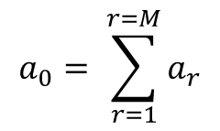
Stochastic simulations
A reaction R_{n}, for example A + B → C, can occur when a molecule of species A and a molecule of species B collide with enough energy. The probability P(n,dt) that the reaction R_{n} occurs during the infinitesimal time interval dt is proportional to the duration of the time interval dt, the number of possible collisions h_{n} (here the product of the number of molecules of species A and B respectively) and kinetics (rate) c_{n} specific to this reaction R_{n}. We obtain:
P (n, dt) = h_{n}c_{n}dt
The term a_{n} = h_{n}c_{n} is called the propensity of the reaction R_{n}.
Each propensity is the probability per unit time that a specific reaction occurs.
If there are M reactions then the probability per unit time that any reaction occurs is just
the sum of the propensity of each reaction.
$$a_{0}= \sum_{r=1}^{r=M}{a_{r}}$$

Slide 8
Stochastic simulations: selecting a random reaction time
The probability per unit time of a reaction occurring is constant until a reaction occurs.
A constant probability per unit time implies exponential decay of the probability that a reaction has not occurred yet:
$P_{unreacted}= e^{−a_{0}(t− t_{ref})}$
where t_{ref} is a reference time (ex: time when the last system reaction occurred)
We deduce that the cumulative distribution for the probability of reaction is:
$$P_{reacted}=1− e^{−a_{0}(t− t_{ref})}$$
The distribution of reaction times is therefore
$$p\left(t\right)=\frac{{dP}_{reacted}}{dt}=e^{−a_{0}(t− t_{ref})}$$
Thus, we need to generate exponentially distributed reaction times. (It will allow to determine the time τ (after t_{ref} ) corresponding to the time when the next reaction will take place is determined).
Notes:
The distribution of reaction times is therefore : la distribution des temps de réaction est donc

Slide 9
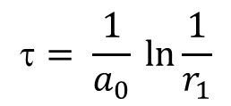
Stochastic simulations: selecting a random reaction time
However most random number generators are based on a uniform distribution between 0 and 1. But a uniform random number r₁ could be convert into an exponentially distributed random number as follow:
$$= \frac{1}{a_{0}} \ln{\frac{1}{r_{1}}}$$

Slide 10
Stochastic simulations: Gillepsie algorithm
The system to be simulated involves:
N molecular species {S₁,. . . , S_{N}} represented by a vector of dynamic state
X (t) = (X₁ (t), ..., X_{N} (t)) where X_{i} (t), is the number of molecules of the species S_{i} in the system at time t
M chemical reactions {R₁,. . . R_{M}}. Each reaction R_{j} is characterized by its propensity
a_{j} and a vector of state change ν_{j} = {ν_{1j},. . . , ν_{Nj}}, where ν_{ij} is the variation of the number of molecules of the species S_{i} due to the reaction R_{j}.
Step 1: Determination of the time τ corresponding to the time when the next reaction will occur.
Generate an random number, r₁ from an uniform distribution [0,1]. Deduce τ
$$= \frac{1}{a_{0}} \ln{\frac{1}{r_{1}}}$$
Step 2: Random choice of the reaction that occurs at time τ
Generate a second random number, r₂ from an uniform distribution [0,1].
The probability that the next reaction to occur is R_{r} is a_{r /} a₀ (a₀ probability per unit time that
any reaction occurs).
Rank the probability of each reaction. Figure out in which reaction interval r₂ falls.
a₁/a₀ | a₂/a₀ | a₃/a₀ | … | a_{r}/a₀
r₂

Slide 11
Stochastic simulations: Gillepsie algorithm
Step 2:
a₁/a₀ | a₂/a₀ | a₃/a₀ | … | a_{r}/a₀
r₂
the index j of the selected reaction is the smallest integer in the interval [1, M] such that:
$$\sum_{k=1}^{k=j}{a_{k}}> r_{2}a_{0}$$
Step 3: the choice of the reaction will change the number of molecules at time (t+τ) for the molecular species that are concerned by the reaction. The vector X (t) = (X₁ (t), ..., X_{N} (t)) will be updated to represent the new number of molecules of each species.
New reaction propensities must be calculated.

Slide 12
Gillepsie algorithm
1. Setup: Store initial populations and rate constants, set t = 0,
2. Calculate reaction propensities.
3. Generate two uniform random numbers, r₁ and r₂.
4. Calculate τ, the time to next reaction, using r₁.
5. Determine the next reaction using r₂.
6. Add τ to t.
7. Update the populations based on the reaction chosen.
8. Go to step 2 until some chosen stopping criterion is reached
(exhaustion of a chemical, target simulation time reached, . . . )
If we want the kind of information we can get from the master equations, many independent runs of simulations must be performed and then average across realizations.

Slide 13
Stochastic Petri net
Stochastic paradigm (SPN): preserves the discrete state, i. e., preserve a discrete number of tokens on its place, but in addition associates a firing rate (waiting time) with each transition, which are random variables defined by probability distributions. The firing rates are typically state dependent and specified by rate functions. All reactions, which occur in the QPN, can still occur in the SPN, but their likelihood depends on the probability distribution of the associated firing rates. Consequently, the system behavior is described by the same discrete space as in the QPN . Thus all qualitative properties valid in the QPN are also valid in the SPN, and vice versa. The underlying semantics is a Continuous-Time Markov Chain (CTMC), and stochastic simulation generates a random walk through the CTMC.
Transitions get enabled if pre-places are sufficiently marked. Before firing of an enabled transition t ∈ T, a waiting time has to elapse.

Slide 14
Stochastic Petri net
Each transition gets its own local timer.
When a transition becomes enabled (enough tokens in its pre-places), the local timer is set to an initial value computed by means of the corresponding probability distribution (in general, this value will be different for each run of simulation). The local timer is then decremented at a constant speed, and when the timer reaches zero, the transition is fired. If many transitions are enabled, a race of the next firing will take place.
Technically, various probability distributions can be chosen to determine the random values for the local timers. Biochemical systems are prototypes for exponentially distributed reactions
The firing rates of transitions will follow an exponential definition which could be described by a single parameter λ.
The firing rate will be described by its own parameter λ to specify its local time behavior.
The waiting time is an exponential distributed random variable X_{t} ∈ [0,∞[ with the probability density function:
The stochastic hazard function h_{t} defines the marking-dependent transition rate λ_{t}(m) for the transition t, i.e. h_{t} = λ_{t}(m). h_{t} will correspond to the stochastic mass-action hazard function. It will depend on the transition-specific stochastic rate constant and on the number of tokens present in the preplaces of the transition t.

Slide 15
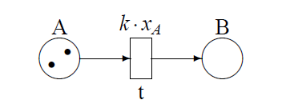
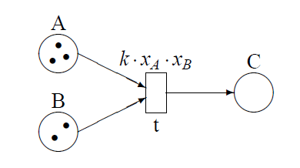
Stochastic Petri net
Example 1:
k is the rate constant of the reaction
transition t is enabled because its input place A is marked. A firing time τ1 is thus chosen for t, drawn from the negative exponential distribution of parameter k x_{A} = 2k, and a clock starts to countdown from t1 to 0. When the clock reaches 0, transition t fires. A new marking is obtained x_{A} = 1, x_{B} = 1.
After the firing, transition t is still enabled, but its rate has now become k x_{A} = k.
Consequently, its new firing time τ2 will be selected from an exponential random variable different from the one out of which τ1 was sampled. Again, a clock is set to countdown until the new firing time is reached. At that time, the marking is changed to x_{A} = 0, x_{B} = 2, where no transitions are enabled anymore and the evolution stops.
Example 2:
Transition t is enabled as both places A and B are not empty.
In the initial marking of the model, there are six several independent ways in which the bimolecular reaction can occur, each one associated to one specific selection of the pair of molecules A and B that react. Thus, the rate associated to transition t in the initial marking is: k x_{A} x_{B} = 6k.
After the firing, the marking is changed to x_{A} = 2, x_{B} = 1, x_{C} = 1
The subsequent firing of transition t will occur at a rate that is: k x_{A} x_{B} =2k.

Slide 16
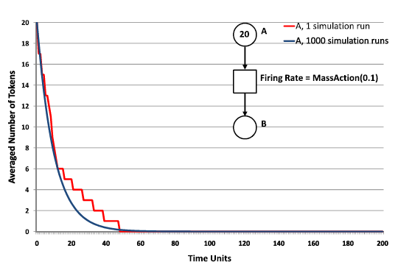
Stochastic Petri net
One simulation run describes at least one path in the state space graph (Gillepsie algorithm).
It is also possible to perform multiple simulation runs and average the results of all runs.
Thus, an averaged time course will be computed. The more simulation runs are performed, the more precise is the averaged time course. All single simulation runs will fluctuate around the averaged time course.

Slide 17
Stochastic Petri net
In stochastic Petri net, new type of transitions (timed transitions) are available:
Deterministic transitions : they have contrary to stochastic transitions a deterministic firing delay which is specified by an integer constant. The delay is always relative to the time point where the transition gets enabled.
Immediate transitions: they are a very special kind of deterministic transitions with zero firing delay, i.e. they fire immediately after getting enabled, and always prior to (general) deterministic and stochastic transitions. Consequently, getting enabled and the firing itself coincide for immediate transitions
Scheduled transitions: they are another special case of deterministic transitions. The deterministic firing occurs according to a schedule specifying absolute points of the simulation time. A schedule can specify just a single time point, or equidistant time points within a given interval, triggering the firing once or periodically. However, transitions only fire at their scheduled time points if they are enabled. Scheduled transitions can dramatically restrict the (qualitative) net behavior. Scheduled transitions can be replaced by net components consisting of immediate and deterministic transitions only; Thus, they do not extend the modelling power.
Scheduled transitions are described by [Start, Repetition, End]. They fire as soon as the fixed time interval elapsed during the given time-points.

Slide 18
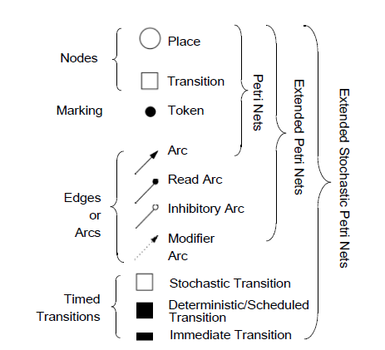
Stochastic Petri net
Summary

